Slide 2
Tumor Markers
Tumor markers are substances that can be detected in higher than normal amounts in the serum, urine, or tissues of patients with certain types of cancer. Tumors markers are produced either by the cancer cells themselves or by the body in a response to the cancer.
can be used as prognostic or predictive markers.
Prognostic marker generally is used to describe molecular markers that predict disease-free survival, disease-specific survival, and overall survival
predictive marker often is used in the context of predicting response to certain therapies

Slide 3
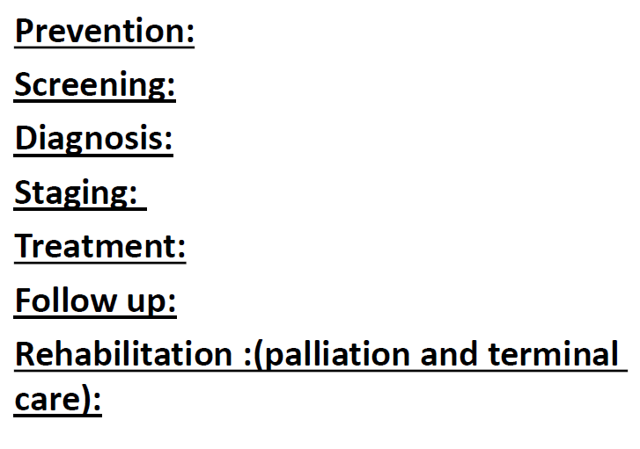

Slide 6
diagnosis
A. Laboratory Examination:
● Biopsy:
○ To document presence of malignancy
○ Types:
1. Needle biopsy (cytological)
2. Incisional biopsy
3. Excisional biopsy
o Rapid frozen biopsy / exfoliative
cytology (Pap smear)

Slide 7
Clinical Staging of Cancer:
TNM:
Stage I = cancer confined to it’s primary site
Stage II = more locally advanced disease
Stage III = metastasis to regional LN
Stage IV = metastasis to distant sites

Slide 8
A. Post-surgical Resection Staging:
● Pathological Staging:
○ The extent of disease using all data available at the
time of surgery and on examination of a
completely resected specimen.
B. Re-treatment Staging:
● Restaging is necessary for additional or secondary
definitive treatment after a (disease-free) interval
following 1st treatment.
C. Autopsy Staging:
● Used only when the cancer is 1st diagnosed at
autopsy.

Slide 9
CANCER TREATMENT:
Interdisciplinary Approach:
1. Surgical resection 55% (40% alone)
2. Radiation therapy 34% (16% alone)
3. Chemotherapy 22% (alone or combination)
○ Surgery & radiation tx represents
treatment of cancers that remains
localized to it’s primary site or regional
LN.
○ Chemotherapy and Immunotherapy
– tx effective against tumor cells already
metastatic to distant organ sites.

Slide 10
GOALS of Therapy:
○ Vary w/ extent of the cancer:
1. Localized w/o evidence of spread:
○ Eradicate the cancer and CURE
THE PATIENT
2. Spread beyond the local site:
○ Control patient’s symptoms and
to maintain maximum activity
for the longest possible period
of time

Slide 11
CRITERIA of Incurability:
2. Distant metastasis (most common)
3. Evidence of extensive local infiltration of adjacent organs or structures
● Pt’s general condition and the presence of any co-existing disease must be
considered in planning therapy.
● The PSYCHOLOGICAL makeup of the
patient and the patient’s life situation must be considered.

Slide 12
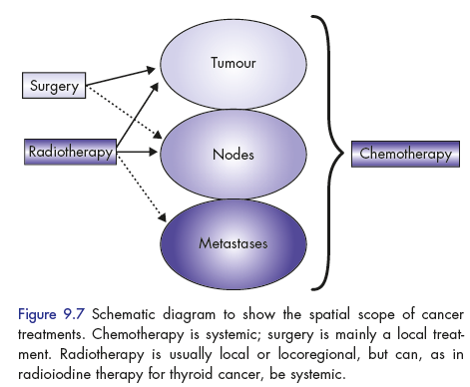

Slide 13
Cancer Prevention
Primary prevention - keeps disease from
occurring by reducing exposure to causative
agents and risk factors
✓ Secondary prevention - detects the disease before it is symptomatic and when intervention
can prevent the illness,
✓ Tertiary prevention - reduces complication of the disease once the disease is clinically evident

Slide 14
Primary Prevention
✓Avoiding the causative agent
✓ Lifestyle risk reduction measures
✓Using an agent that prevents the
development of the malignant process
✓ Chemo-preventive agents
✓ Vaccines

Slide 15
Secondary Prevention
✓Achieved with screening tests
✓Screening tests do not prevent the disease
✓Screening tests are not diagnostics on their own
✓No screening test for most type of Cancers

Slide 16
Criteria for Screening test
Common and severe disease
Long asymptomatic phase during which intervention is beneficial
Effective intervention available
Test sensitive and specific, inexpensive and safe

Slide 17
Screening tests
Annual Mammogram for women > 50 yo
Annual Clinical Breast Examination
Annual Pap Smear for women .
Annual Fecal occult blood testing,
Flexible Sigmoidoscopy and Barium enema every 5 years or Colonoscopy every 10 years

